Slide 1
Closing Thoughts

Slide 2
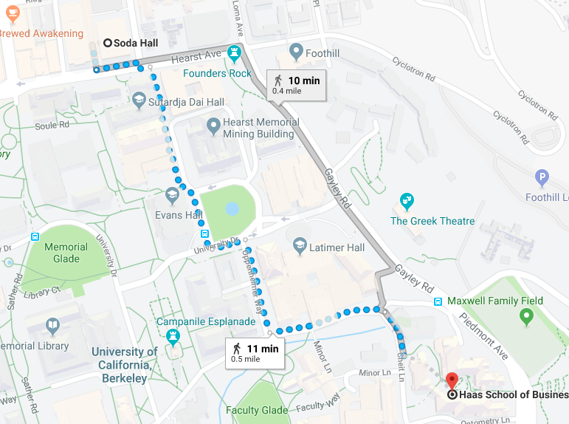
Administrative Announcements
Final Exam
  Thursday 12/13 11:30-2:30 (F295 Haas)
  Cumulative, but focus on HW topics and post-MT2 topics
  2 Pages (front and back) of cheat sheet material
Review Sessions
  Next Tues/Thurs class time (here in Pimentel)\
Office Hours
  Prof H will hold OH Fridays as usual
  this week and RRR
  TA OH info will be posted to Piazza shortly

Slide 3
Lessons
Looking back at what we learned
Looking forward to what it unlocks

Slide 4
What did we learn?

Slide 5



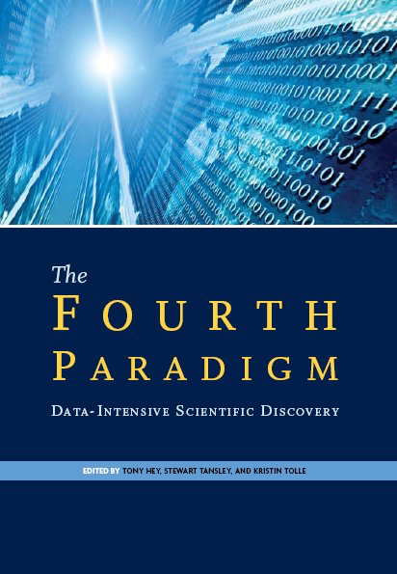



Data is at the center of everything

Slide 6
Data is at the center of everything
Redefining what it means to be a
computer scientist:
Study of Computation and Data
Mastering the concepts in
CS186 has made you a better Computer Scientist

Slide 7
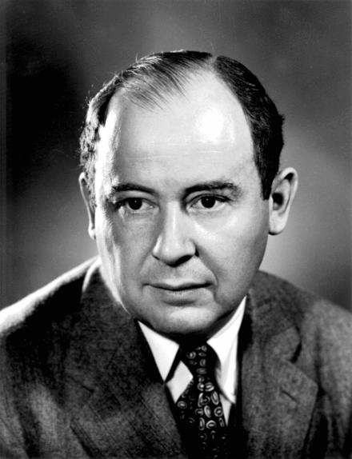
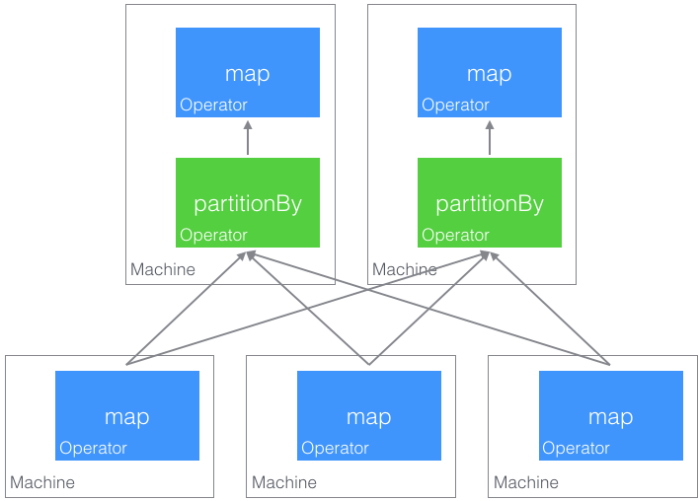
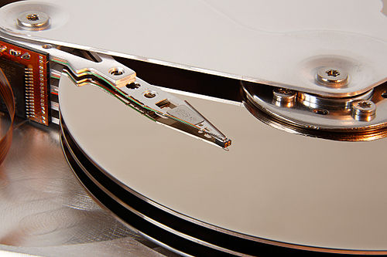
Computation on
Unordered
Collections
John von Neumann
HW3!
Out-of-Core Algorithms
Distributed Algorithms

Slide 8
Scaling across the memory hierarchy: to Pluto and beyond
Andromeda
10
9
Tape /Optical
2,000 Years
Robot
10
6
Disk
Pluto
2 Years
Sacramento
1.5 hr
100
Memory
10
On Board Cache
This Building
10 min
2
On Chip Cache
This Room
1
Registers
My Head
1 min

Slide 9
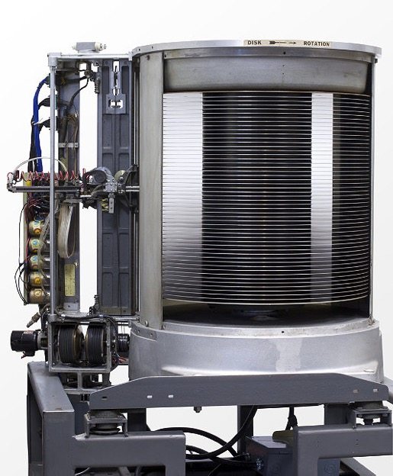
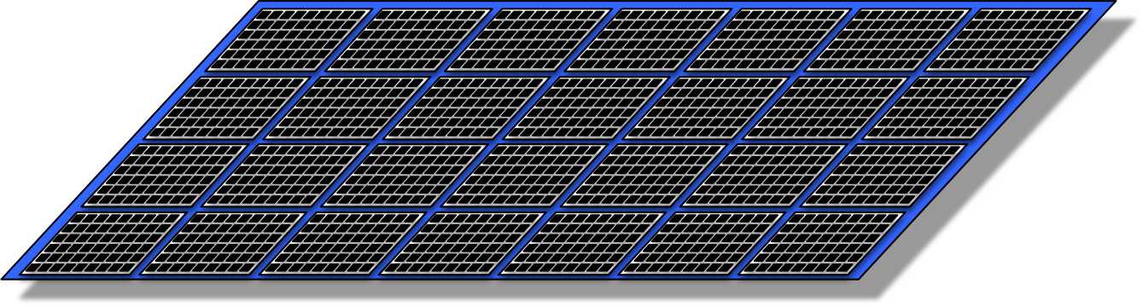
Spanning Decades of Technology
Flash/SSD
Noting opportunities for you to change everything!
  How will cheap random reads change what you learned?

Slide 10

The central concept of Rendezvous
Most of computing is getting the right things together
  In the same place…
  … at the same time!
    Joining
    Caching
    Spilling
    Sharding
    Grouping
    Reducing
    …
And occasionally
in the right order
    Sorting, indexing
    Serializability…
Sailor
Request
Boat
Data

Slide 11
Computation on
Computation on
We taught you a
language for
computing on sets: SQL
that separates the what from the how
and enables the system to choose the best how given the data and representation
In HW1 you became a declarative programmer!
Unordered
Collections
Unordered
Collections

Slide 12
Together
We Unpacked a
Data System and
Explored Modular System Design
SQL Client
Completed
Database Management
System
Query Parsing
& Optimization
Relational Operators
Files and Index Management
Buffer Management
Disk Space Management
Database
You are here

Slide 13
Abstraction at Each Level
Database Management
System
Query Parsing
& Optimization
What → How
Relational Operators
How → Dataflow on Files
Files and Index Management
Files → Blocks in Mem.
Buffer Management
Mem. Blocks → Disk Pages
Disk Space Management
Pages on Disk → Bytes
Database
You are here
Each level hiding the
complexity of the next

Slide 14
We Studied Data Layout, Indexes, Caching
Knowledge of data and access patterns can affect choice of data-layout and caching strategies.
Choice → Challenges → Motivated Query Opt.

Slide 15

We Learned How to Index Stored Data
Where the logs have big bases, the trees are wide and they grow upward

Slide 16
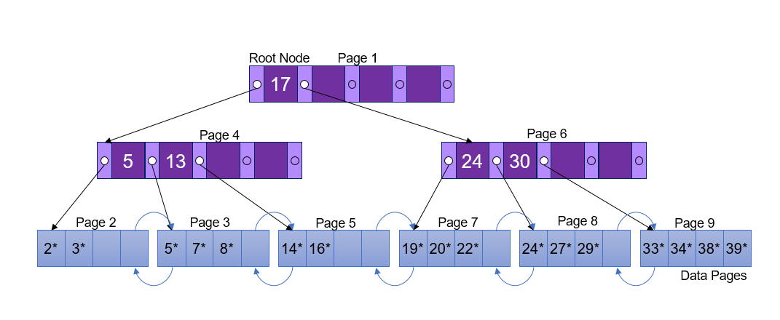
We Learned How to Index Stored Data
Where the logs have big bases, the trees are wide and they grow upward

Slide 17
We Learned How to Index Stored Data
Where the logs have big bases, the trees are wide and they grow upward.
In HW2 you implemented these trees!

Slide 18
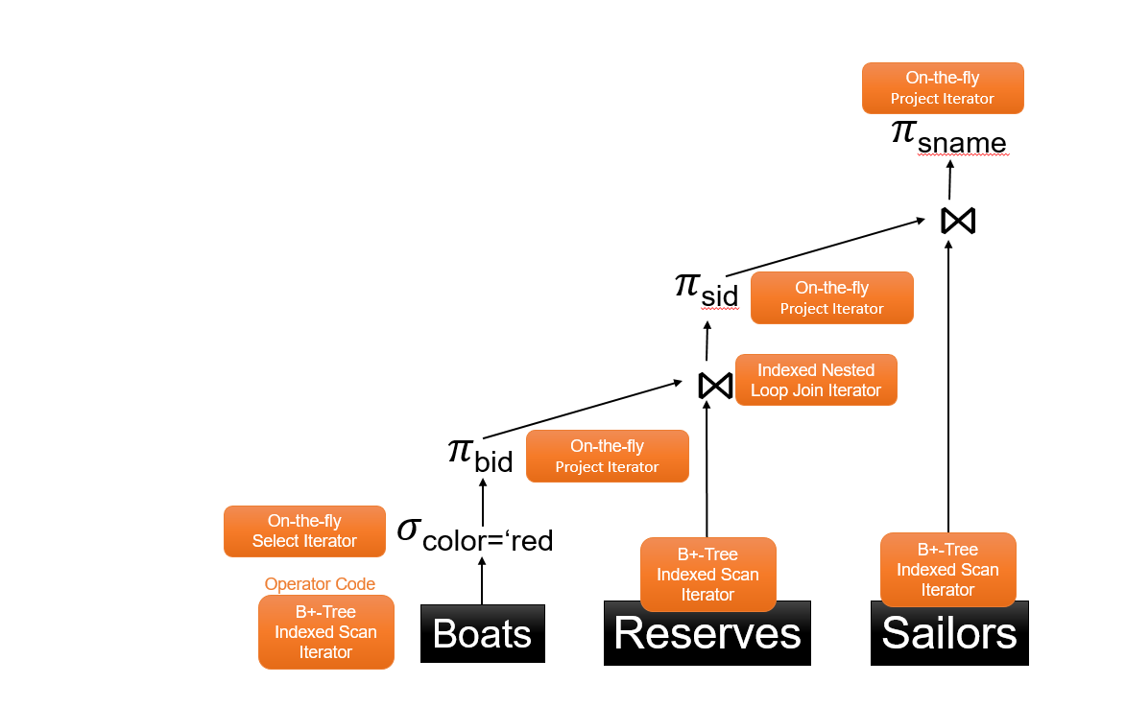
We Learned about Dataflow:
Algebra and Architecture
Simple elegant closed set of operators
  σ π ρ ⋈
Plumbed together via iterators into dataflow

Slide 19
We Learned about Dataflow:
Algebra and Architecture
Simple elegant closed set of operators
  σ π ρ ⋈
Plumbed together via iterators into dataflow
Partitioned and pipelined across machines

Slide 20

We Bridged from What to How
Query optimization!

Slide 21

We Bridged from What to How
Query optimization!
Three part harmony
  Plan Space
  Cost estimation
  Search Algorithm

Slide 22
We Bridged from What to How
Query optimization!
Three part harmony
  Plan Space
  Cost estimation
  Search Algorithm
                You implemented this in HW4.
                Note: Most of today’s popular Big Data frameworks still need a query optimizer of some kind!

Slide 23
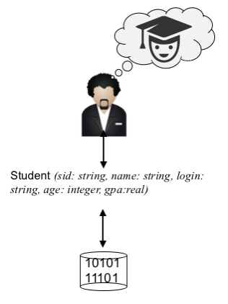
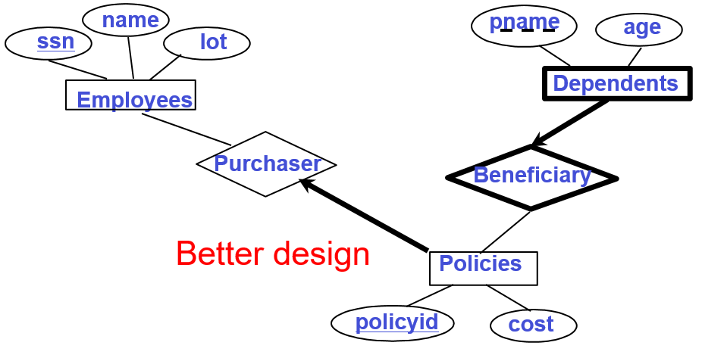
Schema Design… for when it needs to be right
Modeling the world
Data Independence
  Hellerstein’s Inequality
Conceptual design and ER
Schema Refinement, FDs,
Normalization

Slide 24
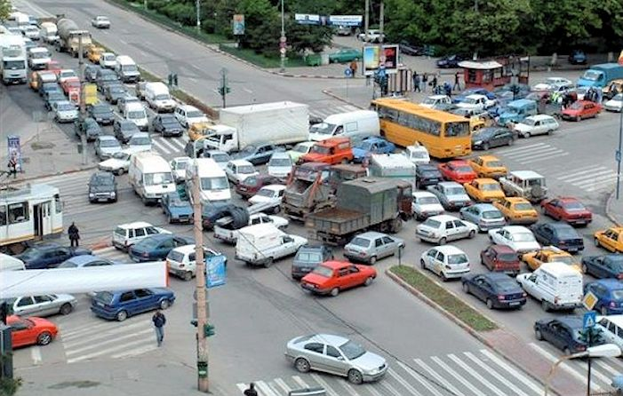
We Mastered Controlled Disorder with Transactions
Correct: serially-ordered
Desire: interleave to maximize performance
Risk: Disorder leads to chaos

Slide 25

We Mastered Controlled Disorder with Transactions
Correct: serially-ordered
Desire: interleave to maximize performance
Risk: Disorder leads to chaos
Allowable orders:
(Conflict) Serializability
Implementations:
(Strict) 2PL
HW5!

Slide 26
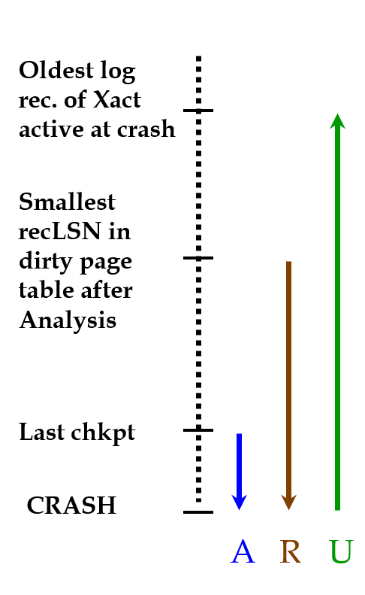
Went through WAL and
3-step Recovery Program
Write-Ahead Logging
ARIES

Slide 27
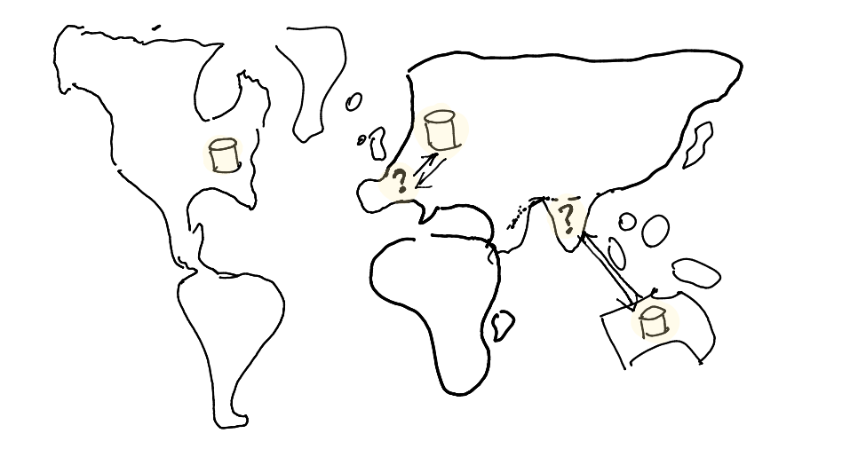
Introduced to Massive Scaling
Speed-up and Scale-up
Types of Parallelism
Distributed Transactions,
Replication, NoSQL

Slide 28
What is it all for?

Slide 29
All of CS is moving to Data Thinking
Data grows rapidly.
The number of cores grows rapidly.
Programming is (parallel) data management.
Data-centric methods unlock parallelism.
  Declarative
  Set oriented
  Disorderly
Data now drives innovation
  Search, vision, robotics, compilers, debuggers, systems…
  … everything gets trained
    “the unreasonable effectiveness of data”

Slide 30
All of Everything is moving to Data
Data-centric, measurement-driven thinking across society
  Government, policy
  Economics
  Medicine
  Science
  Business
  Etc.
There’s more to data than advertising!

Slide 31
What you learned was a snapshot
But data systems are more similar than different!
  Relational DBs
  Big Data Analytics
  NoSQL Key-Value Stores
  Search engines
  File Systems
Don’t learn a system — learn the principles!
  examine how tricks vary across these use cases
  draw connections
  Innovate!

Slide 32
Changes Ahead
Cloud-scale, elastic, serverless
Multicore
Solid State storage
Memory-resident databases
Opportunity to revisit, refactor
  Not just the monolithic relational DBMS of the book
  Maybe disk seek is free
  Maybe queries involve relational AND linear algebra
  Maybe there’s lots of room for multiple versions of data
  Etc. Etc.
You’ve been trained to roll with—and drive—the change!
  Well-grounded and open-minded.

Slide 33
You Have Enormous Value
Job market
  McKinsey Big Data Report, 2011:
    “The US alone faces a shortage of 140,000 to 190,000 people with deep analytical skills as well as 1.5 million managers and analysts to analyze big data and make decisions based on their findings.”
  Choose your own adventure!
    Engineering, entrepreneurship, sales, marketing, ops, mgmt., etc
    systems, applications, data science, …
    big SW firms, web services, startups, corporations, application domains… it’s all Data!

Slide 34
You Have Enormous Potential
Graduate school
  DBs & Data Science now at many top grad programs
  Exciting crossover to other areas

Slide 35
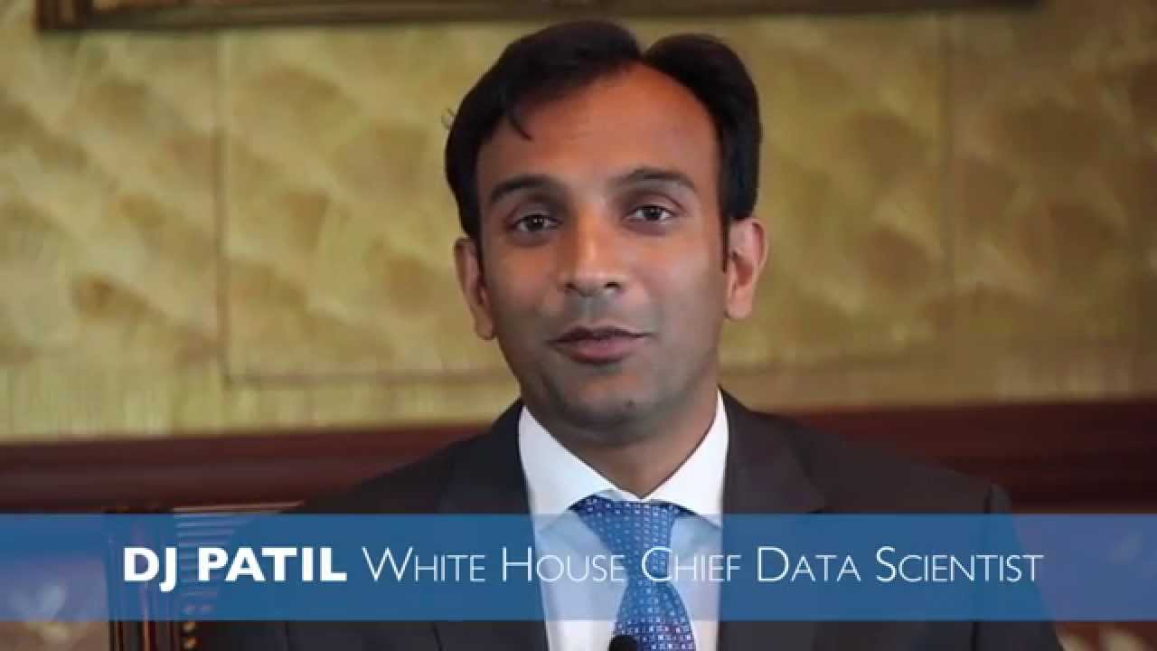
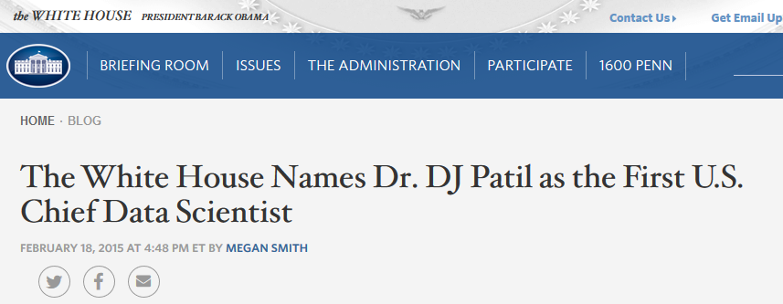
You Have Enormous Potential
Graduate school
  DBs & Data Science now at many top grad programs
  Exciting crossover to other areas
Get involved
  DataKind.org
  CodeForAmerica.org
  Data.gov

Slide 36
“More, more I’m still not satisfied”
Watch for 194’s and Data Science courses
  Data Science 100 could be appropriate
  Data Science 101 under design
Grad classes @ Berkeley
  CS262A: grad level intro to DBMS and OS
  CS286B: grad DB class (maybe next year?)
  Keep eyes open for new grad seminars

Slide 37

Special Thanks
Your Amazing (U)GSIs
  Jason Dai
  Brian DeLeonardis
  Jamie Gu
  Lakshya Jain
  Benjamin Kha
  Kimmy Ko
  Daphne Nhuch
  Eric Sheng
  Yawen (Sabrina) Sun
  Kimberly Zai
They’ll be back!
Follow in their footsteps!

Slide 38
Parting Thoughts
Education is the ability to listen to almost anything without losing your temper or your self-confidence.
-Robert Frost
It is a miracle that curiosity survives formal education.
-Albert Einstein
Humility...yet pride and scorn;
Instinct and study; love and hate;
Audacity...reverence. These must mate
-Herman Melville, Art
The only thing one can do with good advice is to pass it on. It is never of any use to oneself.
-Oscar Wilde

Slide 39
Commit*
End Transaction
Notes:
The slides for this text are organized into chapters. This lecture covers Chapter 20.
Chapter 1: Introduction to Database Systems
Chapter 2: The Entity-Relationship Model
Chapter 3: The Relational Model
Chapter 4 (Part A): Relational Algebra
Chapter 4 (Part B): Relational Calculus
Chapter 5: SQL: Queries, Programming, Triggers
Chapter 6: Query-by-Example (QBE)
Chapter 7: Storing Data: Disks and Files
Chapter 8: File Organizations and Indexing
Chapter 9: Tree-Structured Indexing
Chapter 10: Hash-Based Indexing
Chapter 11: External Sorting
Chapter 12 (Part A): Evaluation of Relational Operators
Chapter 12 (Part B): Evaluation of Relational Operators: Other Techniques
Chapter 13: Introduction to Query Optimization
Chapter 14: A Typical Relational Optimizer
Chapter 15: Schema Refinement and Normal Forms
Chapter 16 (Part A): Physical Database Design
Chapter 16 (Part B): Database Tuning
Chapter 17: Security
Chapter 18: Transaction Management Overview
Chapter 19: Concurrency Control
Chapter 20: Crash Recovery
Chapter 21: Parallel and Distributed Databases
Chapter 22: Internet Databases
Chapter 23: Decision Support
Chapter 24: Data Mining
Chapter 25: Object-Database Systems
Chapter 26: Spatial Data Management
Chapter 27: Deductive Databases
Chapter 28: Additional Topics

